Slide 1
4TH April, Barcelona

Slide 2
Block 1 Policy Perspective - Opportunities within Horizon 2020
10:10 - 10:30 – Abdul Rahim, Director of Vision2020
10:30 - 11:00 – Samuel Maenhout - European Commission - Policy Officer from DG Research & Innovation B3 – SMEs, Financial Instruments and State Aid
11:00 - 11:30 – David Rovirosa, ACCIO Innovation Catalan Agency and EEN
Panel 1 followed by Q&A session
11:30 – 12:00 - Coffee & Networking
Block 2 EU Funded Research and Innovation: Commercial Case Studies + Vision 2020 relevance members
12:00 - 12:15 – Emilie Mespoulhes, LEITAT as a Partner for Technology for SMEs
12:15 - 12:30 – Oonagh McNerney, SME Success story, IRIS (INNOVACIO I RECERCA INDUSTRIAL I SOSTENIBLE SL)
12:30 - 12:45 – Marta Macias , SME Success story (IDENER).
12:45 - 13:00 – Michael Browne, University success story, University College London
Panel 2 followed by Q&A session
13:00 – 14:00 - Networking reception with LEITAT Project Managers

Slide 3
Vision2020: The Horizon Network
“Horizon 2020 for SMEs”
Abdul Rahim
www.2020VisionNetwork.eu

Slide 4
Vision2020: Presentation Structure
The Vision2020 platform
Challenges for SMEs
Why join? Who can join?
Next steps

Slide 5
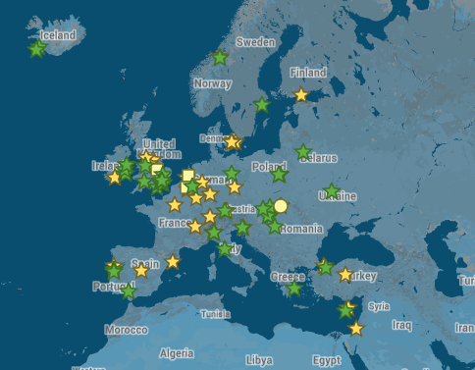
Vision2020: Platform
Multi-sectoral and pan-European, linking
SMEs
RTOs
Expert Members
Associated Partners
Cluster structure
Brings in experts

Slide 6
Vision2020: Challenges for SMEs
Complicated landscape of research organisations
Lack of admin capacity
Long development time scales
Cash flow problems

Slide 7
Vision2020: What’s in it for you?
Visibility
Access to partners
Support
Increased share of EU funding
New SME Instrument with €3 billion budget

Slide 8
Vision2020: Network Model
SME
Policy Hub
ICT
Energy
Climate
Society
Bio-economy
Transport
Health
Materials
Nanotech
RTO

Slide 9
Vision2020: Network Model
Policy Hub
ICT
Energy
Climate
Society
Bio-economy
Transport
Health
Materials
Nanotech
Energy
Smart Grids
Carbon
Capture

Slide 10
Vision2020: Membership Structure
Vision2020: The Horizon Network
Track record
Excellence
RTOs
Industry
SMEs
Experts

Slide 11
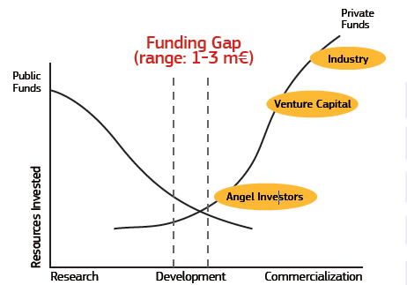
Vision2020: New SME Instrument

Slide 12
Network update: Launch date 19th April 2013
92 members across 25 countries
36 RTO members
50 SME members
4 Expert members
2 Associated Partners
67% of EU countries represented and 6 Non-EU Members

Slide 13
Vision2020: Member Research Organisations

Slide 14
Network update 2
Google+ Community:
230 participants - members only
Work Programmes released significantly ahead of official publication.
Since the Horizon 2020 funding calls were launched on 11 December 2013, many of our members have begun to form consortia and some have started writing proposals.
Collaboration and Consortia:

Slide 15
Case Studies
Spectrum Aerospace Research Corporation, COMPET-06-2014
Partner Search via Vision2020 online platform

Slide 16
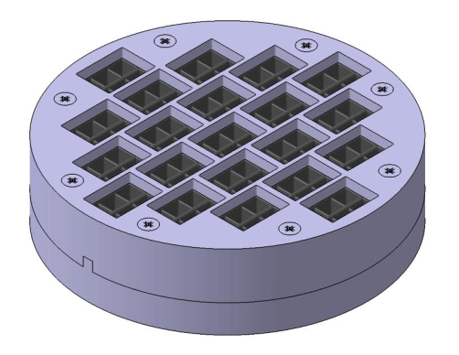
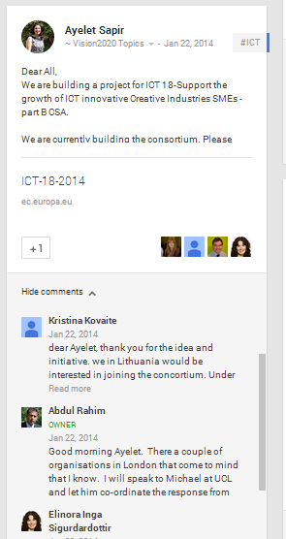
Case Studies
LEITAT and Design and optimization of compressor valve
Vision2020 member UCL advertised on the platform on behalf of SME. LEITAT responded and are now working with Proximo Technology

Slide 17
Vision2020: More Benefits…
Your opportunity to propose relevant research work
Once only joining fee: €700
Network meetings and events across Europe
Access to experts with a track record
Early access to discussions on Horizon 2020 Work Programmes
Flexibility to join projects short term or long term

Slide 18
Vision2020: The Horizon Network
Questions and Answers
www.2020VisionNetwork.eu

Slide 19
Vision2020: Keep in touch
Email: contact@2020visionnetwork.eu
Twitter: @V2020net
Newsletter: bit.ly/v2020net
Website & Membership: www.2020VisionNetwork.eu/sme

Slide 20
4TH April, Barcelona

